Slide 1
Connect New Mexico Pilot Program Wave Three Mapping Review Process to Validate Eligible Service Areas May 2023
Office of Broadband Access and Expansion

Slide 2
Agenda
Topics
Agenda
Purpose of Mapping Challenge Process
Relevant NOFO Guidelines
Wave Three: Projects Overview
Wave Three Map (Demonstration)
Process to File Mapping Challenge

Slide 3
Purpose of Mapping Challenge Process
The Mapping Challenge process complements the Merit Review process.
Review Process:
Two Distinct but Complementary Tracks
Merit review that applies a scoring rubric to assess the strengths and weaknesses of the applications
Project impact; Community Engagement; Economic Efficiency; Project Readiness; Organizational Qualifications; Marketing/Services Strategy; Adoption Assistance Programs; Sustainability
Mapping review that closely examines the eligibility of the proposed projects’ service area
Designed to ensure that an applicant’s service areas only involve unserved or underserved areas
Unserved Premise: A household or business location that lacks access to a wireline-based broadband connection with a reliable data rate of at least 25 Mbps download and 3 Mbps upload
Underserved Unit: A household or business location that has access to a wireline-based broadband connection that reliably offers at least 25 Mbps download and 3 Mbps upload but less than 100 Mbps download and 20 Mbps upload

Slide 4
Threshold for Unserved and Underserved Premises
The 80% threshold allows for overbuild in limited circumstances.
Purpose of 80% Threshold
NOFO Definition
Areas in which 80% of the household and business locations in the applicant’s Project Area are either unserved and/or underserved.
Purpose
The 80% threshold aims to accommodate scenarios that do not involve intentional overbuild but provide flexibility when required. This includes several scenarios, for example:
Served premises which are inevitably passed by the wireline path on its way to connect unserved and/or underserved units
Example: A wireline network has to pass served households on the way to unserved premises because those served units stand at the entry point of a neighborhood.
Example: The network’s middle-mile span crosses served units, and while the budget does not fund drops, the middle-mile infrastructure is funded.
A wireless network propagates into served areas as the signals inevitably permeate across a broad project area.
Issues exist regarding the merit/accuracy of the data which indicates served – e.g., reliability concerns about the speeds offered.
The served premise(s) -- e.g., especially a business or community institution -- may significantly enhance the business case (e.g., anchor client).
Other reasonable cases based on consideration of engineering, financial, or operational assessments

Slide 5
Challenges Pertain to Both Existing and Planned Broadband Services
The mapping challenge process invites feedback from service providers with an existing or planned network. Please see the NOFO for the Connect New Mexico Pilot Program.
NOFO Guidelines
Existing service providers which can provide evidence that the Project Area is currently served
Awardees and beneficiaries from another federal or state funding program that plan to deploy a broadband network and make commercial services available within a reasonable time period from the NOFO issuance date (e.g., two years);
Entities that have made substantiated progress in launching a network.
This includes the demonstration of: a) comprehensive business and technical plan; b) funding secured; c) detailed budget; d) detailed project plan that supports the launch of commercial services within two years of the NOFO issuance date.

Slide 6
Overview of Wave Three Projects
OBAE received applications for 28 projects.
Technology
28 Projects
22 fiber
4 fixed wireless
1 tower infrastructure
1 hybrid fiber/fixed wireless
$133.5M in grant requests leveraged by $49.7M in match contributions for a total budget size of $183M
Over 43,000 unserved and underserved premises
Over 1,100 fiber miles
Geographic Areas
11 Southern Region
9 Northern Region
7 Central Region
1 Statewide
Organization Type
7 private ISP’s (accounting for 20 projects)
5 tribal affiliated
1 telephone cooperative
1 electric cooperatives (accounting for two projects)

Slide 7
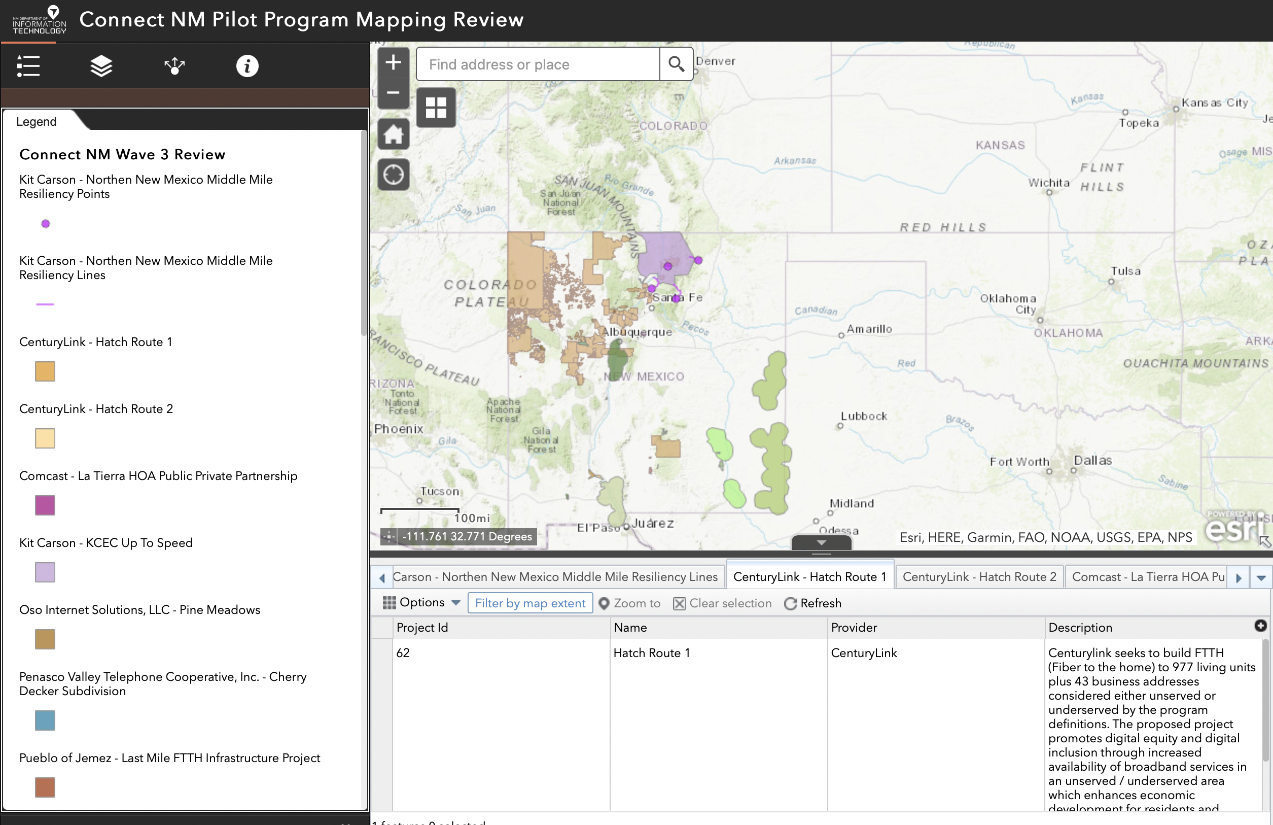
Wave Three Map
OBAE has updated the Map with all provided application polygons from the proposed project service areas as of May 12, 2023.
Website: https://nmdoit.maps.arcgis.com/apps/webappviewer/index.html?id=a94bf13b899c4993aad03dda921723d6

Slide 8
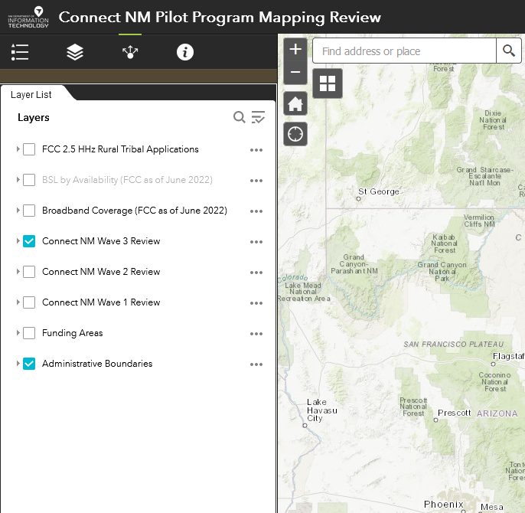
Connect NM Review Map – Federal/State Data
The Review Challenge Map showcases several data sets from federal and state sources.
Broadband Availability (BSL/BDC)
Federal Awards
FCC 2.5 GHz Rural Tribal Applications
CAF I & II Areas
FCC RDOF Awards
USDA Reconnect Awards
HUBB Data (Deployment location data for Federal awards)
State Awards
Connect NM Wave 3 Proposed Areas
Connect NM Wave 1 & 2 (awarded and proposed areas)
NM PRC
Administrative Boundaries
County and Tribal boundaries
8

Slide 9
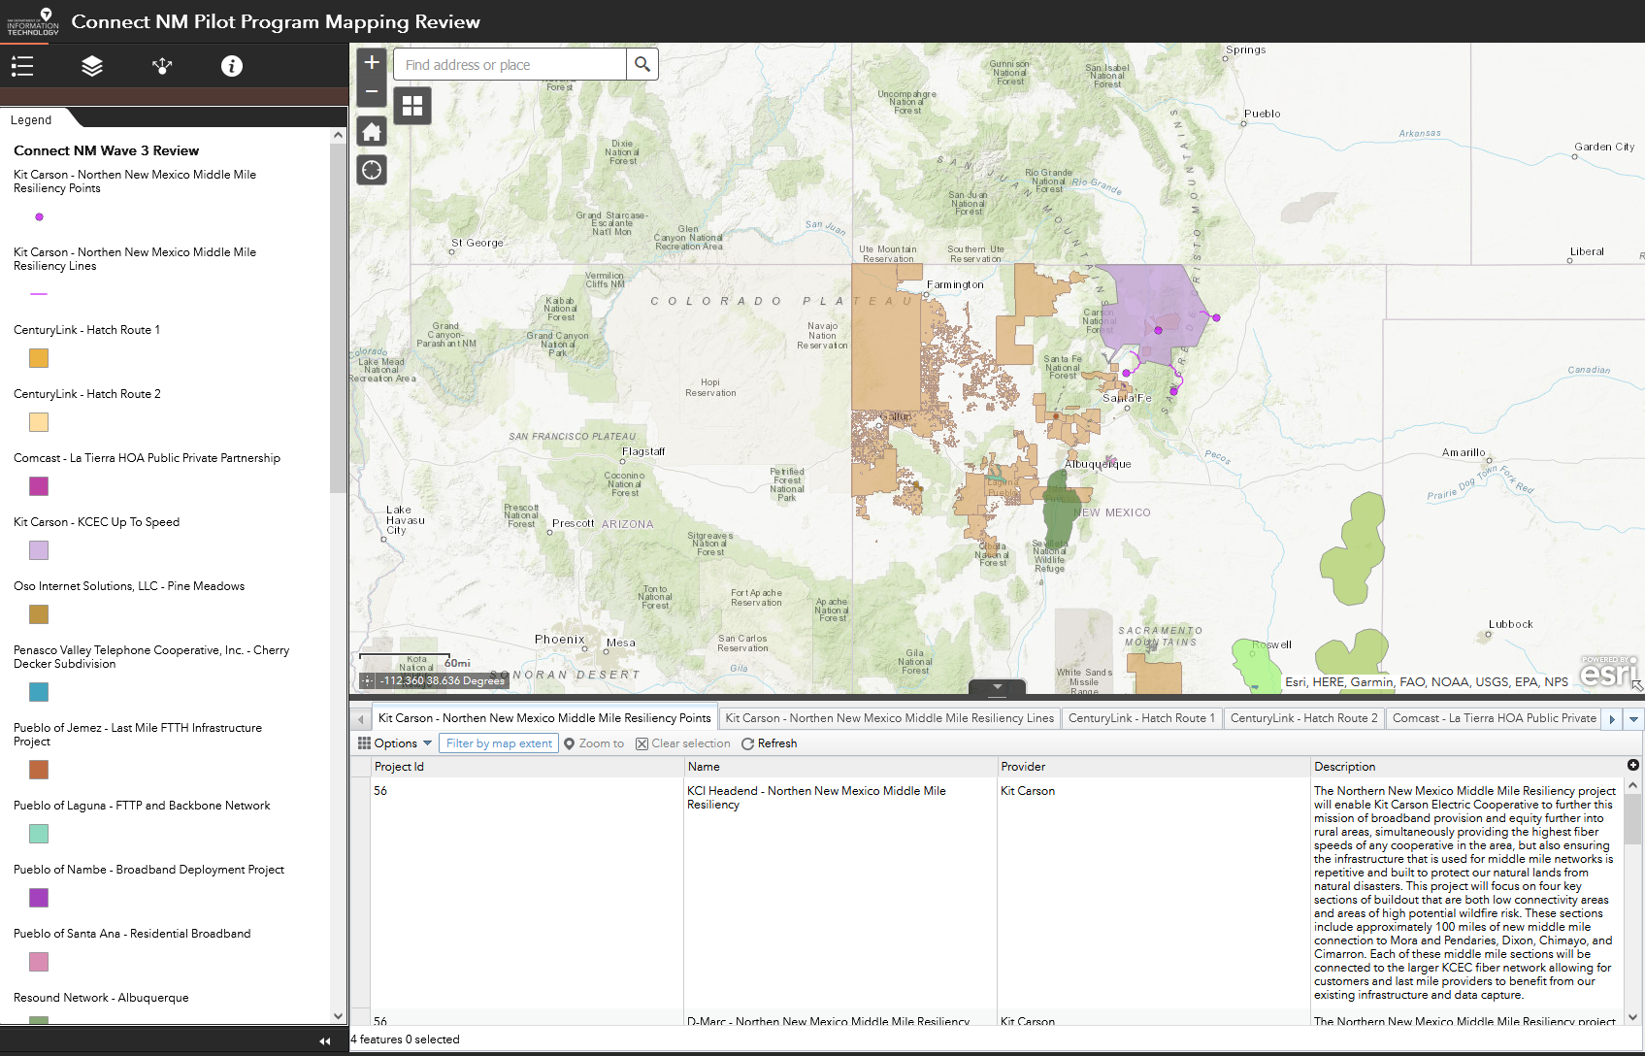
Connect NM Grant Review Map – Project Data
The Review Challenge Map includes relevant project details.
Individual project layers can be accessed via layer list from the left hand menu or from the table at the bottom of the map via tabs.
Information includes:
Project ID
Project Name
Applicant/ISP Name
Project Description
9

Slide 10
Process to File a Challenge
Please adhere to the following procedural guidelines.
Content
Content
Provide OBAE with shapefiles and specific location addresses that have demonstrated wireline service at or above the program eligibility threshold of 100/20 Mbps.
Please share the latest availability filings provided to the FCC in the Broadband Data Collection (BDC) system (as of December 31, 2022)
Include the following in the header of your email: Project Name, Applicant, and Unique ID.
Address
Send the challenge to: broadbandpilot@state.nm.us
Note: OBAE will confirm receipt of challenge.
Deadline
May 26, 2023 (5 p.m. MT)
Post-Challenge Next Steps
OBAE team may invite your team to further discuss and understand the challenge.
Invite the Applicant to remove overlapping areas if the challenge has merit -- i.e., reliable wireline-based services offering at least 100/20 Mbps.
OBAE will notify the challenger if that challenged project is funded.

Slide 11
Discussion
Questions/Answers

