Slide 2
Executive Overview
Title (Qualified Title Co.)
Mapping (Professional Engineer / Surveyor)
Valuation (Appraisal & Appraisal Review (Certified Appraiser)
Acquisition & Condemnation (Qualified Staff)
Project Certification & Reimbursements

Slide 3
U. S. Constitutional Limitations on Power of Eminent Domain
5th Amendment
“…nor shall private property be taken for public use without just compensation.”
14th Amendment
“…nor shall any State deprive any person of life, liberty, or property, without due process of law…”

Slide 4
Uniform Act
Uniform Relocation Assistance and Real Property Acquisition Policies Act of 1970, as amended
(Public Law 91-646)

Slide 5
When Must an Agency Follow The Uniform Act ?
When any phase of a project is federally-funded, and:
Real property is acquired, and/or
Property owners and/or tenants are displaced as a direct result of land acquisition, demolition or property redevelopment

Slide 6
Code of Federal Regulations
49 CFR Part 24 – Department of Transportation
23 CFR Part 710 - Highways

Slide 7
State DOT and LPA Relationship
State DOT oversees LPA’s administration of project
LPAs should consult State DOT for assistance

Slide 8
FHWA Oversight Agreements
Agreement between FHWA Division Office and State DOT
Addresses property-related FHWA oversight and approval actions for non-interstate projects
State DOT responsible for oversight of LPAs
23 CFR 710.201

Slide 9
Title
1
A thirty-three year certified title search (or more if required) for every parcel affected in the right or way acquisition. This applies to right of way Takes (Fee Simple Parcel) and Construction Maintenance Easements (CME’s).

Slide 10
Title
1
A Chain of Title (Index) reflecting all transactions affecting each parcel and copies of all pertinent documents described in the Chain of Title.
A five year tax search (computer printout) reflecting the current assessed owner, address, description of property and the status and amount of taxes for the current assessed year and whether they are paid or unpaid.

Slide 11
Title
1
Title sheets(s) that show current owner and address of record and description of property being abstracted.
Work map and index identifying each parcel abstracted.

Slide 12
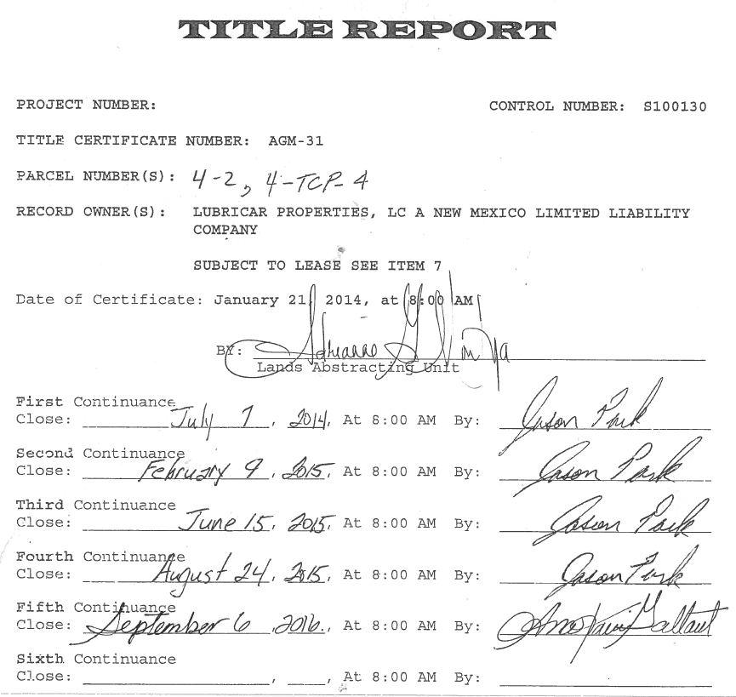
Title
1

Slide 13
Title
1
A certified current ownership report is required for all Temporary Construction Permits (TCP’s). The Title Certificate should show the current owner and address of record, the description of the property and the document creating ownership

Slide 14
Title
1
Prior to commencing consultant title work, a mandatory meeting with Consultant Project Manager, Title Company research staff and NMDOT Lands abstracting Unit staff is required. The Lands Abstracting Unit will issue a clearance letter authorizing the commencement of work.
Title reports must be prepared in accordance with the LANDS ABSTRACTING UNIT HANDBOOK VOLUME II dated January 1, 2016.

Slide 15
Title
1
Title reports are good for 6 months from the date of the certification.
Title reports will require updating as a project progresses and must be current when submitting mapping, engaging an appraiser and making offers for acquisition and payments to property owners. All updates must be attached to the original Title Report.

Slide 16
2
Lands Engineering Section
Survey and Lands Engineering Division
Right of Way Mapping

Slide 17
2
NEW MEXICO DEPARTMENT
OF TRANSPORTATION
RIGHT OF WAY MAPPING
DEVELOPMENT PROCEDURES
SURVEY & LANDS ENGINEERING DIVISION
May 2017 (DRAFT)
1.0 INTRODUCTION
The acquisition of Rights-of-Way (R/W) required for construction projects is one of the most critical activities that needs to be accomplished so that the project development process can be finalized and the project can be let to contract. It is therefore extremely important that final R/W requirements be determined early in the project development process in order for R/W mapping to be completed in a timely manner. Early completion of R/W maps will allow sufficient time to carry out all R/W Appraisal and Acquisition activities.

Slide 18
2
Permanent R/W - To accommodate all permanent features, including slopes, drainage structures, R/W fencing, etc. R/W shall extend a minimum of ten (10) feet beyond slope limits and pertinent construction features, unless circumstances do not make this possible.
R/W Parcels shall be named as follows:
Construction Maintenance Easements (CMEs) - to be used in all cases where there is a need for construction and/or ongoing maintenance, i.e., drainage channels, certain drainage structure fences, etc. The property owner receives compensation for use.
CME Parcels shall be named as follows:
Temporary Construction Permits (TCPs) - to be used in cases where there is a benefit accrued to the NMDOT and there is a temporary need to enter and use a property for construction or maintenance purposes, but not an ongoing need for maintenance, i.e. detours, significant changes to driveway turnouts, etc. The property owner receives compensation for its use. If a project requires no R/W other than TCPs, a R/W Map is not prepared and the TCPs are to be shown in the construction plans referenced to centerline of construction stationing, with offset distances. If necessary, TCPs may be accompanied with an exhibit for detailing purposes. Examples can be requested from Lands Engineering, Verifications Unit. TCPs are not to be used for Cut and Fill slopes.

Slide 19
2
The Lands Engineering Unit will transmit R/W MAPS AND DOCUMENTS (PROPERTY LAND DESCRIPTIONS AND TITLE REPORTS) for acquisition to the Right of Way Bureau for the initiation of R/W activities (Appraisals, Review Appraisals, Title Review, Acquisition, etc.). Copies of the R/W maps for acquisition will be forwarded to the appropriate District Office, PDE, Right-of-Way & Monumentation Unit, and the Environmental Division. The Final Design Division's PDE and or Engineer and Designer shall assure that the R/W requirements shown on the R/W Maps for acquisition correspond to the requirements shown on the Construction Plans.
It is the responsibility of the Design Consultant Engineer to carry out all CONTRACT delegated tasks (Location Survey, Design, Alternative Studies, R/W Surveying, Title Searches, R/W Mapping, Access Control Meetings, Property Owner Interviews, Coordination, Correspondence, Documentation, etc.) required to produce an acceptable set of Final R/W Maps and Documents.
R/W Mapping prepared by Consultants are required to go through a Verifications process in-house. Projects will go through two formal map reviews (Initial and Final) and if additional reviews are required, they are subject to being charged to the Consultant in the form of Liquidated Damages. The Consultant Engineer/Surveyor responsible for the individual projects is responsible for the accuracy of the R/W Survey and Mapping.

Slide 20
2
NEW MEXICO DEPARTMENT OF TRANSPORTATION
SURVEYING & LANDS ENGINEERING DIVISION
1120 CERRILLOS RD. - P.O. BOX 1149
SANTA FE, NEW MEXICO 87504-1149
GENERAL OFFICE ROOM B-31
PHONE (505)827-5570 REVISED : May 3, 2017
(505)827-0659
(505)827-5676
The consultant and or surveyor should contact the Lands Engineering Verification Unit Supervisor of the Surveying and Lands Engineering Division as to the appropriate scale, latest standards, policy and procedures etc. and obtain the latest example of R/W Maps, Land Descriptions and Government Plats before commencing preparation of mapping, documents, etc.
CHECKLIST FOR FINAL R/W MAPPING PROJECTS
(MAP REVIEW SUBMITTALS)
An appropriate letter of transmittal containing NMDOT New Mexico Project Number (N.M.P. No.), project control number (PCN), and a list of all items submitted, and what action is requested.
Submittal shall include two sets of R/W Maps for acquisition (100%complete); Preliminary Property Ownership Layout Maps; a list or letter with total number of parcels, CME'S, TCP'S and title reports submitted; a R/W mapping checklist; property descriptions for affected parcels, TCP lists (Electronic Excel Spreadsheet is available if needed); one (1) set of latest construction design plans; an electronic or hard copy of the coordinate system listing for all points pertinent to the R/W Map with point number, descriptor, x, y, z, and station offset; an electronic or hard copy of closure report for each parcel (showing parcel number together with point numbers, distances, and bearings, and with area in acres and square feet); submit all approved to form certified title reports for each affected parcel; KMZ files submitted are to include existing R/W lines, property/boundary/easement lines, and all new parcel lines Incomplete submittals will be returned as “Unacceptable for Review”.
R/W mapping checklist boxes provided below following each numerical designation are to be checked off by the professional surveyor in responsible charge when the particular item has been completed.
By signing off on the signature line following the checklist items, the Surveyor is agreeing that each item described in the checklist is complete.
If any portion of the alignment has changed or if substantial changes have occurred after first review, these changes, revisions, etc. should be brought to the attention of the PDE and or Consultant Engineer and Lands Engineering Manager.

Slide 21
2
(“APPROVED FOR ACQUISITION” FINAL MAP SUBMITTAL)
An appropriate letter of transmittal containing NMDOT New Mexico Project Number (N.M.P. No.), project control number (PCN), and a list of all items submitted, and what action is requested.
Submittal shall include one paper set of signed and certified R/W Maps for acquisition (Complete); property descriptions for affected parcels and TCP lists along with electronic Microsoft files; submit all updated approved to form certified title reports for each affected parcel; an electronic CAD file with all associated reference files utilized to prepare and develop the final R/W mapping product. KMZ files submitted are to include existing R/W lines, property/boundary/easement lines, and all new parcel lines.
If necessary, a final checklist with all checklist item boxes provided below following each numerical designation are to be checked off by the professional surveyor in responsible charge when the particular item has been completed.
By signing off on the following signature line for all checklist items, the Surveyor is agreeing that each item described in the checklist is complete.
_____________________________________________________________________________________
XXX X. XXXXXXXX N.M.P.S. NO. XXXXX DATE
After final review comments are completed
(FINAL MAP SUBMITTAL “MYLAR”)
Once all R/W has been acquired and final right of way certification is provided, a final certified Mylar R/W map will be submitted (excluding TCPs) for NMDOT records.
An appropriate letter of transmittal containing NMDOT New Mexico Project Number (N.M.P. No.), project control number (PCN), and a list of all items submitted, and what action is requested.

Slide 22
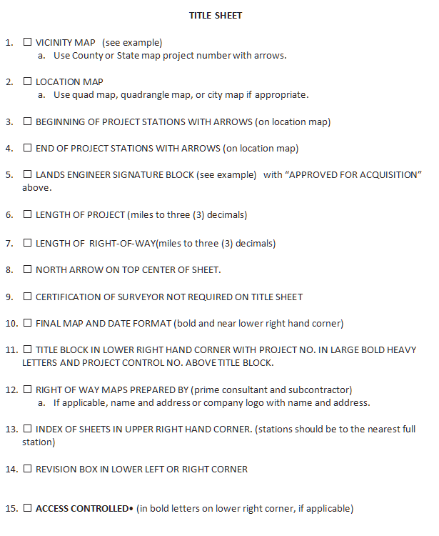
2

Slide 23
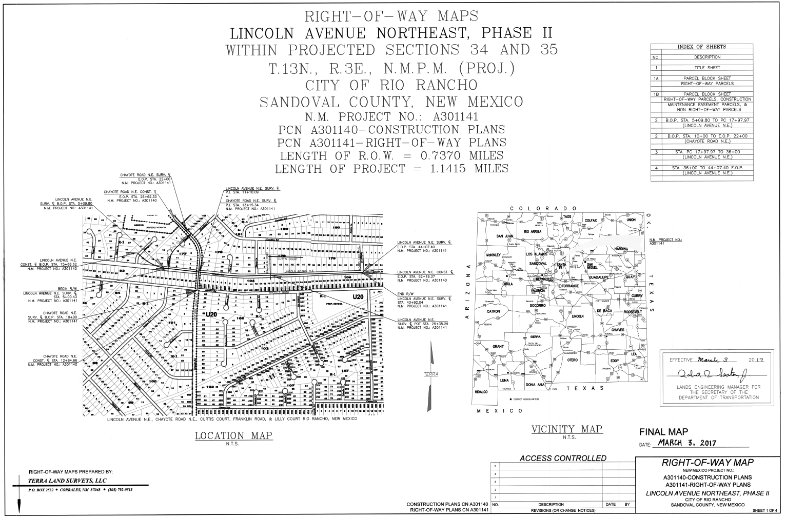
2

Slide 24
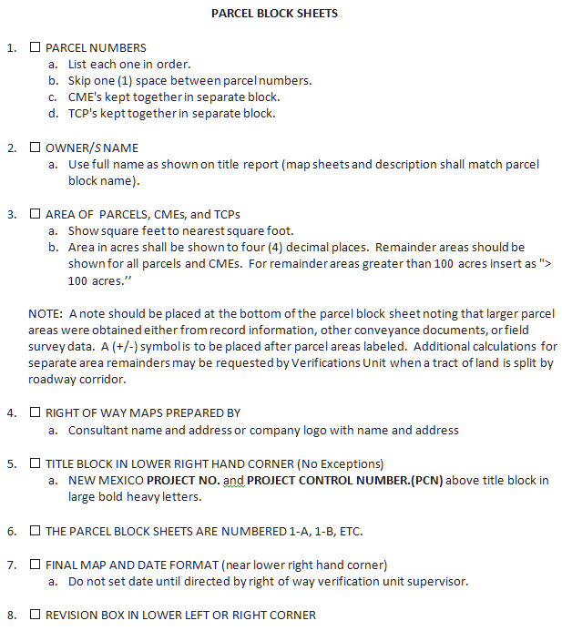
2

Slide 25
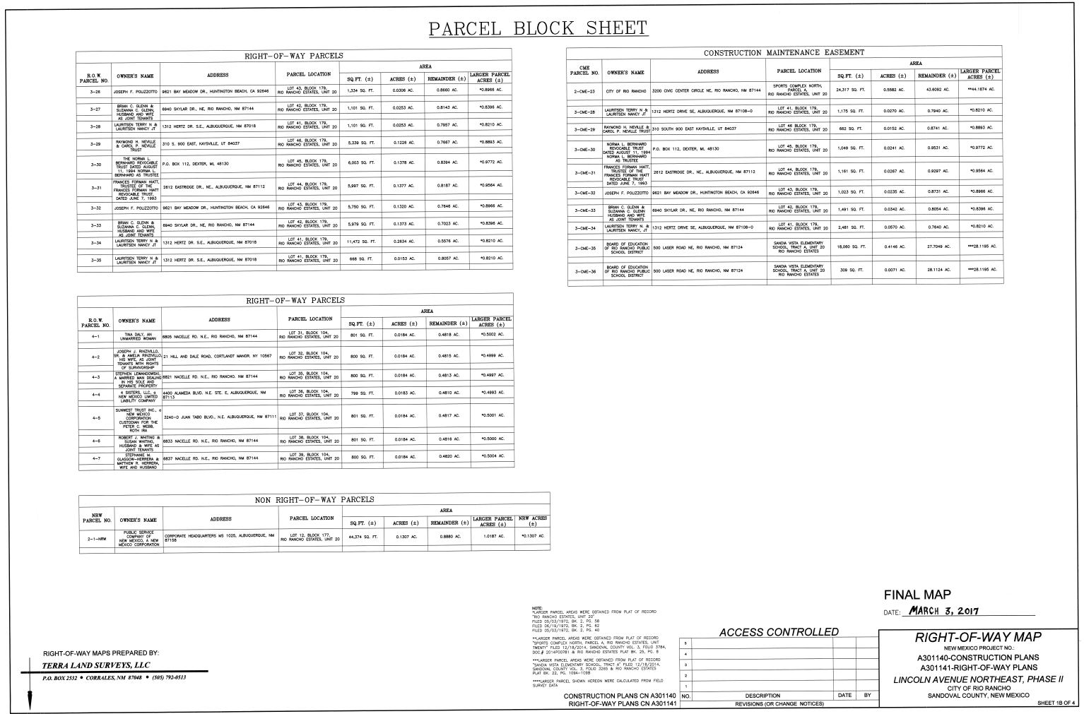
2

Slide 26
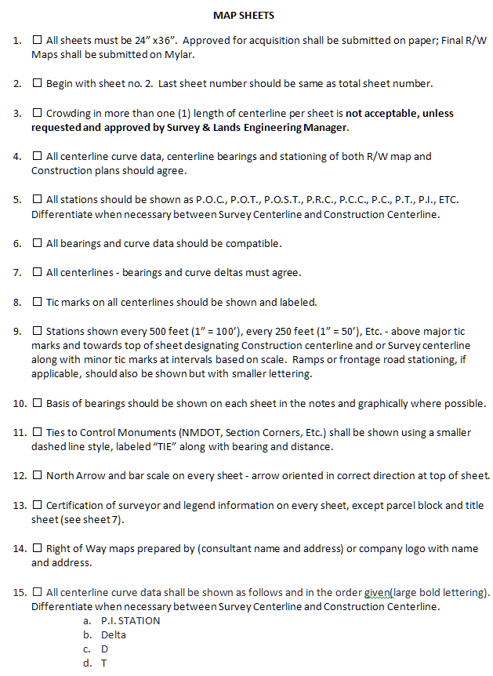
2

Slide 27
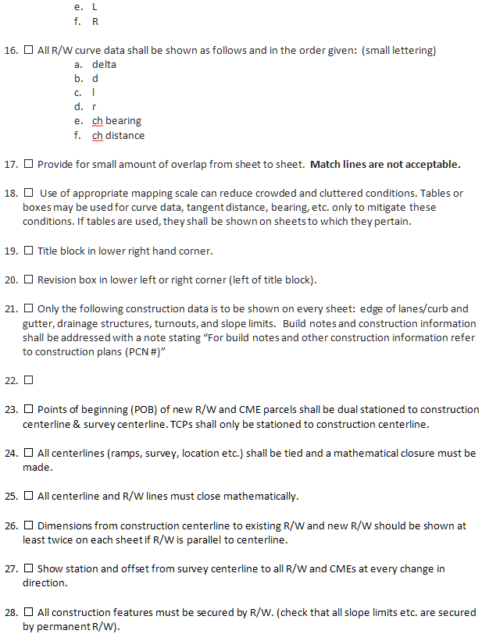
2

Slide 28
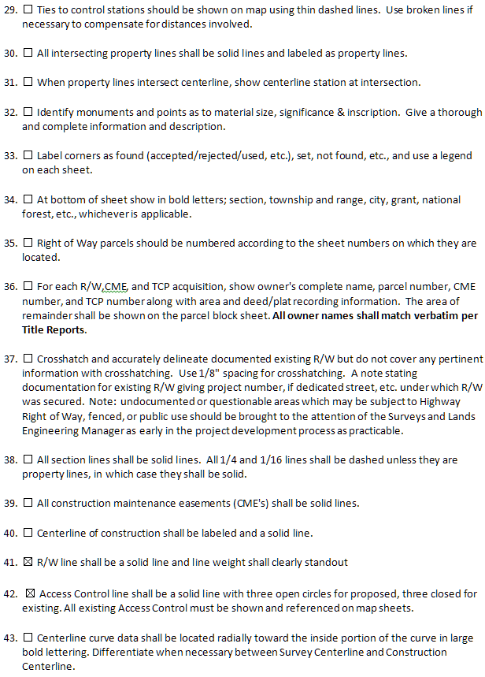
2

Slide 29
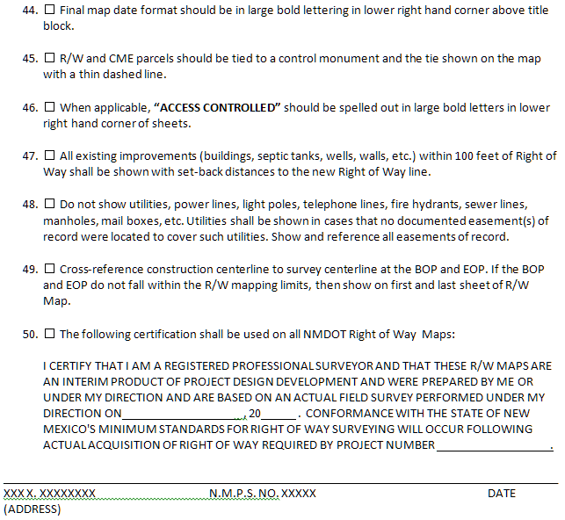
2

Slide 30
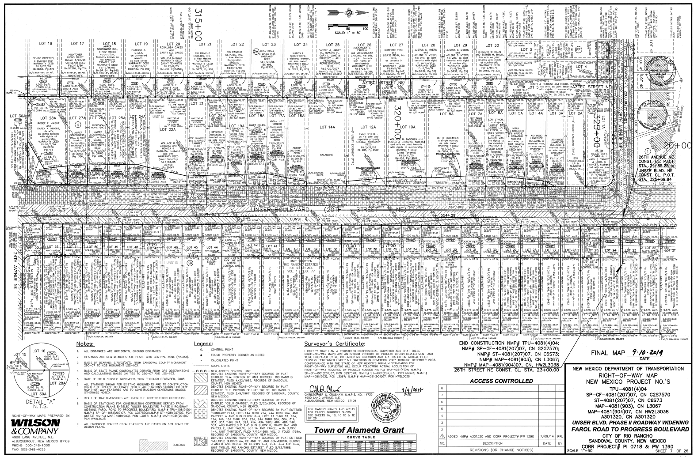
2

Slide 31
2
DESCRIPTIONS
☐ All calls when referred to in the description shall be shown on map.
☐ Check property description thoroughly.
☐ Each description shall have the project number, parcel number, and if CME, its intended purpose (feature)., the name of the property owner exactly as shown on title report, along with seal and certification. (see example)
☐ Use complete curve data as on maps, including chord bearing and distance. Follow samples available from Lands Engineering Section.
☐ In preamble, include quarter, section, township, range, land grant, tribal land, county, and/or other information (e.g. subdivision information)along with recording (deed/plat) information referenced.
☐ In preamble, break down the location of a parcel as far as a quarter of a quarter section (where applicable). No further division is necessary. Do not include exceptions.
☐ Ties to control monuments should be shown on map. Use ties to existing (found or set) monuments only.
☐ The point of beginning of all parcels shall be dual stationed to the survey and construction centerline and tied to a section corner, 1/4 corner or other acceptable control monument.
☐ TCP's are to be described on a standard form called out as construction centerline station to station and distance away from R/W. Forms are available from the Lands Engineering Section. When TCP's are located within areas being mapped, the TCP's shall be shown on the maps and on the parcel block sheet.

Slide 32
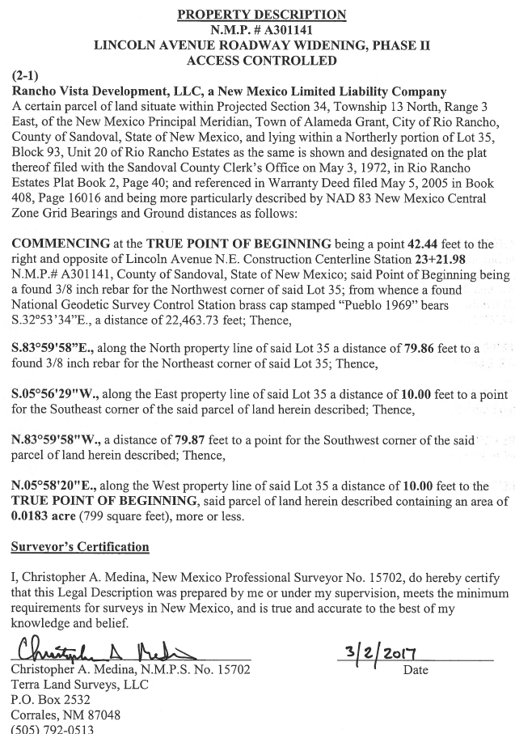
2

Slide 33
2
GOVERNMENT PLATS
Government plats are used in conjunction with legal documents to make application for the acquisition of Highway Right of Way involving Bureau of Land Management Properties and properties under the jurisdiction of the State Land Office. Samples of both the plat and property descriptions are available through the Lands Engineering Section Manager.
☐ Government application plats (8 ½” x 11”) on a scale of 1”=1000’ are required when taking R/W through Bureau of Land Management Lands and state land under the jurisdiction of the State Land Office.
☐ The Lands Engineering Section of NMDOT will provide the forms and plat format for drafting the government plats.
☐ On State Land Office Application Plats (8 ½” x 11"), area of take of every 1/16 section shall be shown on plat (see sample).
☐ On State Land Office Application Plats, the length of Right of Way is required in “rods.” The Lands Engineering Section Manager shall clarify this information required in order to make appropriate application to the State Land Office.
NOTE:
On projects thorough National Forests, new Right of Way Easement Description Applications will be required as per memorandum of understanding dated 9-18-96. Early attention should be given to determining if Forest Lands are involved within the Project Limits and if so, brought to the attention of the Lands Engineering Section Manager.
This checklist and related sample documents furnished by the Lands Engineering Section of the Surveying and Lands Engineering Division are provided as instruments of assistance to the consultant and are not intended to be an exhaustive or limiting treatise on Right Of Way mapping requirements and serves only as an aid for the user. The consultant remains responsible for the efficient and timely development and completion of the Project Work in accordance with the Contract provisions, applicable professional engineering/surveying principles and practices, regulations, minimum standards for Surveying in New Mexico, manuals, and laws and standards. The user should contact the Research & Verifications Unit Supervisor of he Lands Engineering Section with any questions on Right Of Way mapping component of each Project.

Slide 34
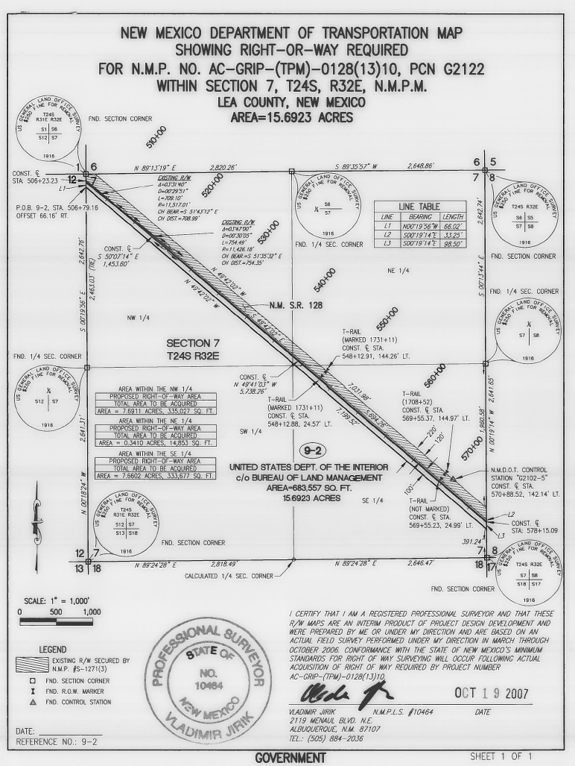
2

Slide 35
Temporary Construction Permit (TCP)
2
TCP (MAPS & LISTINGS)

Slide 36
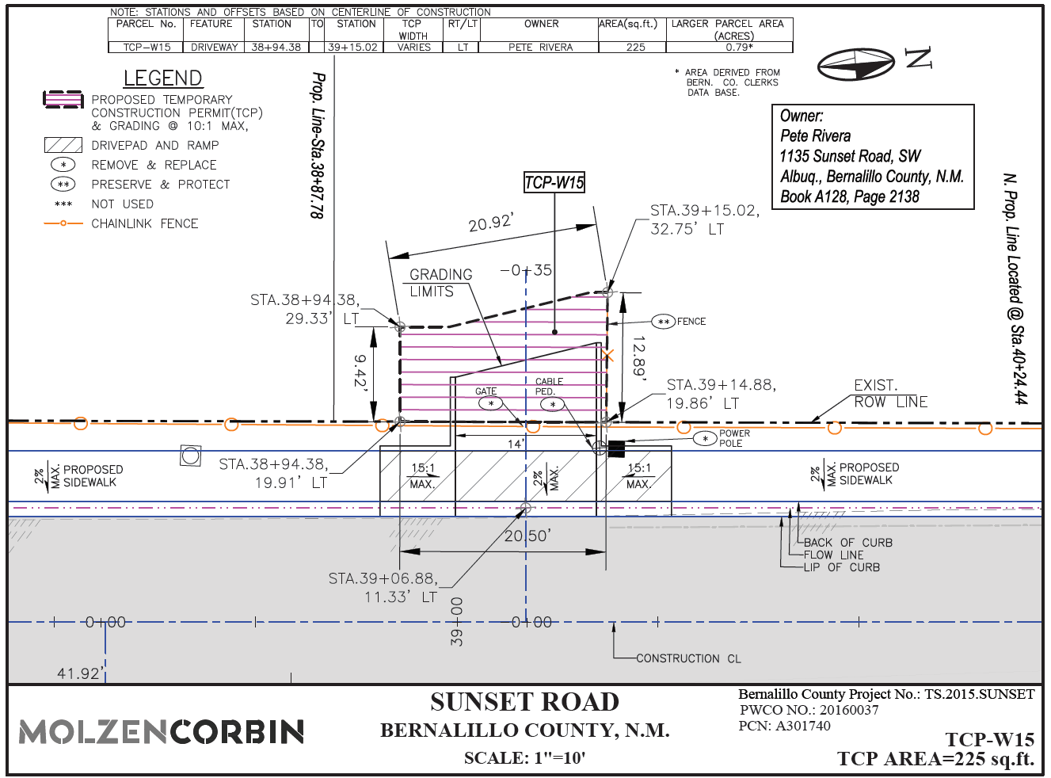
2

Slide 37
Temporary Construction Permit Listing
2

Slide 38
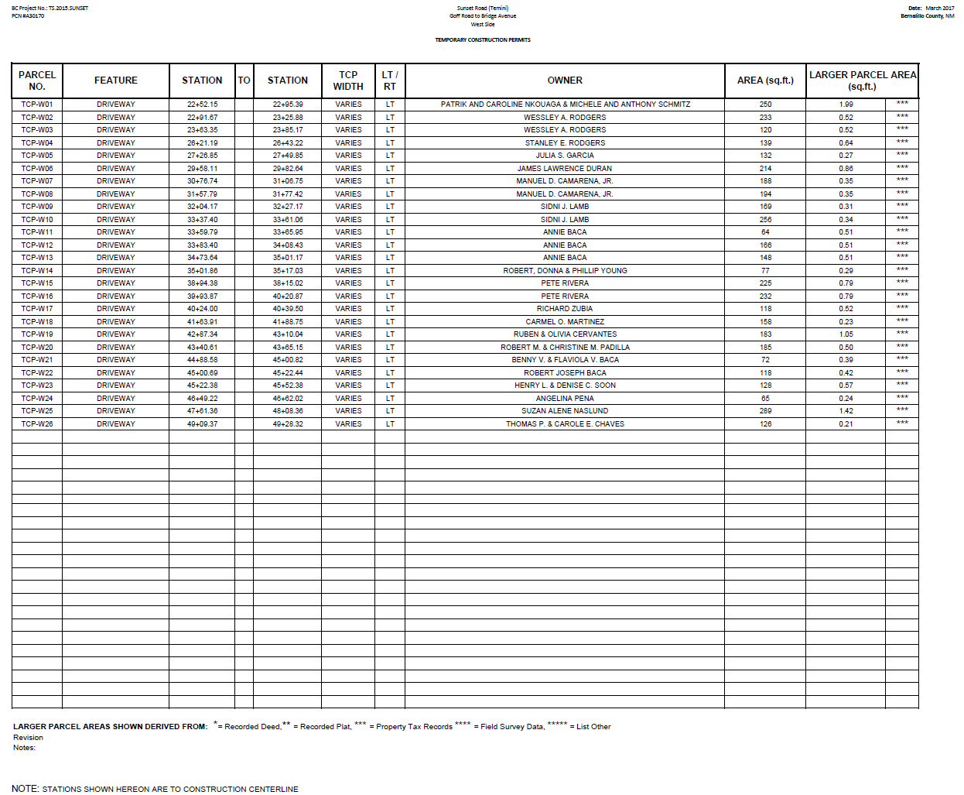
2
Temporary Construction Permit Listing

Slide 39
Selecting and Contracting with Appraisers
3
Before LPA hire an appraiser, consult with NMDOT
Appraisers must be State certified
Appraisers must meet NMDOT qualifications (NMDOT approved list)
Appraisal process cannot commence until final ROW map approval

Slide 40
Appraisal/Review Timeframe
3
Project size will determine the Appraisal and Review process. For a typical project up to 15 ownerships
Appraisal Process: up to 60 days
Review Process: up to 45 days

Slide 41
Information/Documents needed to schedule Appraisal Review
3
1) A brief overview of the project
2) Appraisal RFB/Fee information
3) Name of the selected Appraiser/ Appraisal Firm
4) The signed Scope of Work/ Engagement Letter . to the selected appraiser
5) Number of appraisals to be submitted .

Slide 42
Information/Documents needed to schedule Appraisal Review (cont’d)
3
6) Expected delivery date of appraisals
7) Production date of the project
8) Most updated Final ROW maps (pdf) with .kmz file
9) Construction plans of the project (pdf)
10) Updated title reports
11) An official request for appraisal review.

Slide 43
Information/Documents needed to schedule Appraisal Review
3
After NMDOT has received the required information from the LPA, the project will be scheduled and we will work with the project appraiser/appraisal firm to complete the appraisal review.
To make sure we provide quality services to all LPA projects, please report your project in the early stage and update us in a regular basis.

Slide 44
Uneconomic Remnants
3
Property remnant with little or no value or utility to the owner
49 CFR 24.2(a)(27)
Agency must offer to acquire uneconomic remnants 49 CFR 24.102(k)
Entity must confer with State DOT prior to disposal of any Uneconomic Remnants (Federal Aid)

Slide 45
Acquisition Process
4
Right of Way acquisition takes on average 6 months to complete
Type of project does change the required timelines
No short cuts around the acquisition process
Acquisition Agent must be qualified to perform acquisition activities

Slide 46
Acquisition Process (cont’d)
4
T/LGA is required to provide qualifications for all acquisition staff to ROW Bureau for review and approval.
Owners of property rights to be acquired must be treated fairly, equitably and consistently.
All reasonable efforts to contact property owner must be made.

Slide 47
The Offer
4
Formal Offer must be made to property owner; must contain “statement of offer”
Property owner has 30 days to review offer. (49 CFR part 24.102(f))
Property owner may counter offer/must present support for value they are seeking

Slide 48
The Offer (cont’d)
4
After 30 days a letter of intent is sent to property owner. They now have 25 days to respond. (NMSA 42A-1-5)
After 25 days if you have not secured right of way, you submit for condemnation.
Preliminary order of entry may take 4-6 weeks to obtain.

Slide 49
Closing The Deal
4
Obtain all necessary releases, payment of taxes
Prepare execute Deeds/Documents
Pay just compensation to the property owner – PAYMENT BEFORE POSSESSION
Pay property owner’s expenses incidental to transfer of title to Agency (49 CFR 24.106)

Slide 50
Administrative Settlements
4
Purchase price for property exceeds amount offered as just compensation
T/LGA Official approves settlement as reasonable, prudent and in the public interest
State DOT approval is required
Federal-aid participation requires written justification supporting the settlement

Slide 51
Donations
4
Real property may be donated for project right of way
Property owner must be notified they are entitled to compensation and an appraisal
Features must not be traded for donations
Must be environmentally cleared.

Slide 52
Donations (cont’d)
4
Property owners must not be coerced or pressured into donating property.
Project team should not speak to owner about donation
Contact State DOT for guidance and required forms.

Slide 53
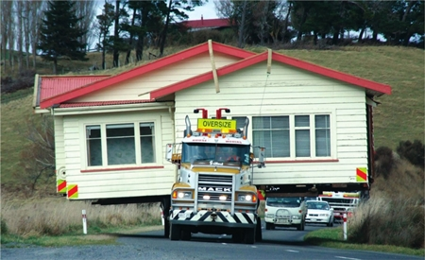
Relocation
4
DON’T DO IT!!!!!!!
If you get to this, contact the State DOT immediately for guidance

Slide 54
Tribal Lands
4
Again, DON’T DO IT!!!!!
Right of Way timelines increase
Appraisal must be coordinated with State DOT & Office of Special Trustee (OST)
Requires Bureau of Indian Affairs (BIA) involvement & approvals
Must be coordinated with the Right of Way Bureau from the get go

Slide 55
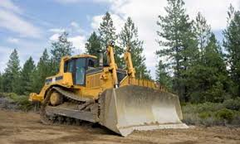
Government Lands
4
Bureau of Land Management, US FOREST SERVICE, State Land Office etc…
Existing MOU between FHWA, NMDOT and the Federal Agency
Must be coordinated with the Right of Way Bureau from the get go

Slide 56
Encroachments
4
Unauthorized use of public right of way for any purpose other than transportation and/or placing of any type of structure or personal property into public right of way without written consent.
An intrusion into, under, upon, or over highway right of way
All encroachments should be noted on project plans

Slide 57
Encroachments (cont’d)
4
Property Management Unit of the Right of Way Bureau may provide guidance when dealing with encroachments on State and Federal highways and Local Government lead projects.
All encroachments must be addressed prior to final right of way certification being issued

Slide 58
Eminent Domain
4
The legal doctrine that government has the power to acquire private property for public purposes
Governments invoke eminent domain proceedings as a last resort

Slide 59
Condemnation
4
Legal process to invoke eminent domain
Conducted in a judicial venue

Slide 60
Condemnation (cont’d)
4
The T/LGA shall notify the Department of how they will be handling condemnation proceeding prior to beginning acquisition activities. Qualified staff attorneys or qualified fee attorneys with experience in eminent domain are highly recommended.

Slide 61
Acquisition Record Keeping
4
Acquisition Agent shall maintain timely, complete and adequate records of all negotiations on an ownership basis – Individual file
Records shall be written in permanent form
Must document each contact with property owner

Slide 62
Acquisition Record Keeping (cont’d)
4
Must contain copies of the Title Report, Reviewed and Approved Appraisal, Formal Offer letter, Right of Way map, copies of signed contract, signed and notarized conveyance documents, any releases, justification for administrative settlements and State DOT approval
Finished report shall be signed and dated by the Acquisition Agent

Slide 63
Acquisition Record Keeping (cont’d)
4
Records must be kept for at least 3 years from submittal of the final request for ROW reimbursement
Records must be available upon reasonable request by State DOT and FHWA personnel

Slide 64
Right Of Way Certification
5
Following completion of all right of way activities (Title search, Survey/mapping, Appraisals and Review, Acquisition, and Relocation) and prior to receiving authorization to advertise the physical construction for bids, the T/LGA shall submit a formal request for “Final Right of Way Certification” to the State DOT Local Government Coordinator, prepared on the Agencies letterhead and addressed to the Right of Way Bureau Chief.

Slide 65
Right of Way Certification (cont’d)
5
The request must contain the following:
Scope of work/ Project termini
That there is no right of way necessary for that project and that the project is being constructed within the existing right of way. (Or)

Slide 66
Right of Way Certification (cont’d)
5
Certify that all of the necessary new right of way for the project has been fully acquired. (identify what right of way was acquired. i.e., 24 takes 10 CME’s, 42 TCP’s) in accordance with
23 CFR 635.309 (c)(1)
Statement regarding relocation

Slide 67
Right of Way Certification (cont’d)
5
Statement of Encroachments
(how many; ALL MUST be addressed)
Statement regarding hazardous material and contamination
Must provide ISA determination letter and Environmental clearance letter.

Slide 68
Reimbursement for ROW Activities
5
Reimbursement for any of the costs of right of way activities must be specifically addressed in the Joint Powers Agreement (JPA) or Cooperative Project Agreement CPA).
For the processing of reimbursements, the following shall be submitted:

Slide 69
Reimbursement for ROW Activities (cont’d)
5
A formal request prepared on the requesting agencies letterhead.
Any contracts between the T/LGA and fee appraisers, fee title examiners, or fee negotiators.
All invoices showing specific charges and proof that payment has been made for the actual parcels.

Slide 70
Reimbursement for ROW Activities (cont’d)
5
Copies of all appraisals
Any settlements above the reviewed and approved amount of the original appraisals, with supporting documents justifying the settlement and NMDOT concurrence

Slide 71
Reimbursement for ROW Activities (cont’d)
5
All submittals will be reviewed for accuracy and duplication before payment is made according to Right of Way monitoring procedures. The reimbursement must be approved by the Right of Way Bureau prior to payment being made.

Slide 72
Reimbursement for ROW Activities (cont’d)
5
The Right of Way Bureau may provide guidance regarding any questions or issues concerning the reimbursement process.

Slide 73
Overall We’re All In This Together

